Slide 1
Attribute Data Types

Slide 2
SQL Data Types define the type of value that can be stored in a table column. For example, if we want a column to store only integer values, then we can define it’s data type as int.
The basic data types available for attributes include
  numeric,
  character string,
  bit string,
  Boolean,
  Date and time.

Slide 3
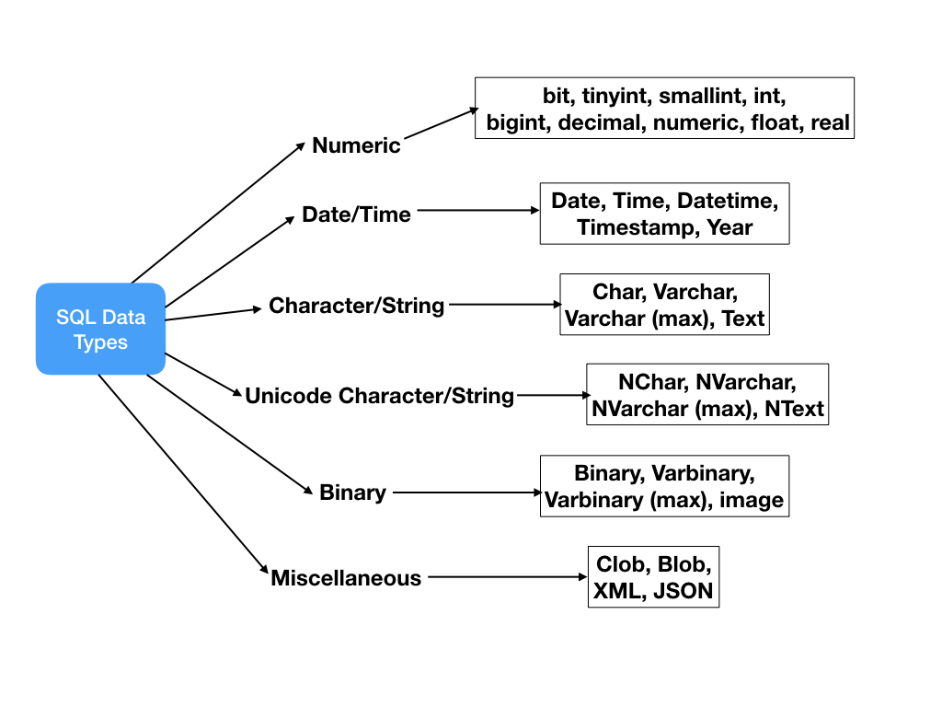

Slide 4
Numeric
Numeric data types include integer numbers of various sizes (INTEGER or INT, and SMALLINT) and floating-point (real) numbers of various precision (FLOAT or REAL, and DOUBLE PRECISION).
Formatted numbers can be declared by using DECIMAL(i,j)—or DEC(i,j) or NUMERIC(i,j)—where i, the precision, is the total number of decimal digits and j, the scale, is the number of digits after the decimal point.

Slide 5
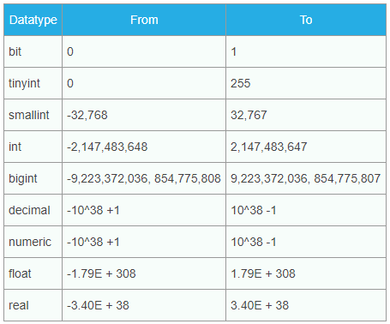

Slide 6
Character-string
Character-string data types are either fixed length CHAR(n) or CHARACTER(n), where n is the number of characters or varying length VARCHAR(n) or CHAR VARYING(n) or CHARACTER VARYING(n), where n is the maximum number of characters.
For example, if the value ‘Keren’ is for an attribute of type CHAR(10), it is padded with five blank characters to become ‘Keren ’.
There is also a concatenation operator denoted by || (double vertical bar) that can concatenate two strings in SQL.
For example, ‘abc’ || ‘XYZ’ results in a single string ‘abcXYZ’.

Slide 7
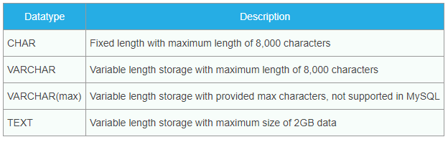

Slide 8
Bit-string
Bit-string data types are either of fixed length ‘n’ BIT(n) or varying length BIT VARYING(n), where n is the maximum number of bits.
Bit strings are placed between single quotes but preceded by a B to distinguish them from character strings.
for example, B‘10101’.

Slide 9
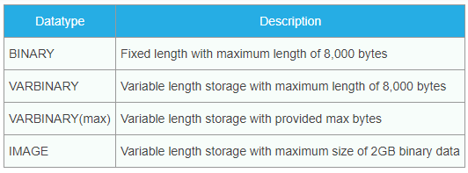

Slide 10
Boolean
A Boolean data type has the traditional values of TRUE or FALSE.
In SQL, because of the presence of NULL values, a three-valued logic is used, so a third possible value for a Boolean data type is UNKNOWN.

Slide 11
DATE and TIME
The DATE data type has ten positions, and its components are YEAR, MONTH, and DAY in the form YYYY-MM-DD.
The TIME data type has at least eight positions, with the components HOUR, MINUTE, and SECOND in the form HH:MM:SS.
A TIME WITH TIME ZONE data type includes an additional six positions for specifying the displacement from the standard universal time zone, which is in the range +13:00 to –12:59 in units of HOURS:MINUTES.
If WITH TIME ZONE is not included, the default is the local time zone for the SQL session.

Slide 12
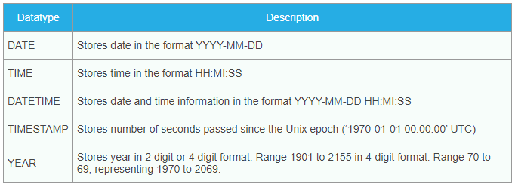

Slide 13
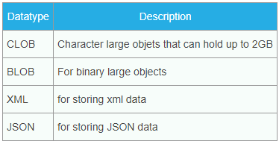

Slide 14
Points to be noted:
Not all data types are supported by every relational database vendors. For example, Oracle database doesn’t support DATETIME and MySQL doesn’t support CLOB data type. So while designing database schema and writing sql queries, make sure to check if the data types are supported or not.
Data types listed here doesn’t include all the data types, these are the most popularly used data types. Some relational database vendors have their own data types that might be not listed here. For example, Microsoft SQL Server has money and smallmoney data types.
Every relational database vendor has it’s own maximum size limit for different data types.

